Slide 1
Housing Project

Slide 2
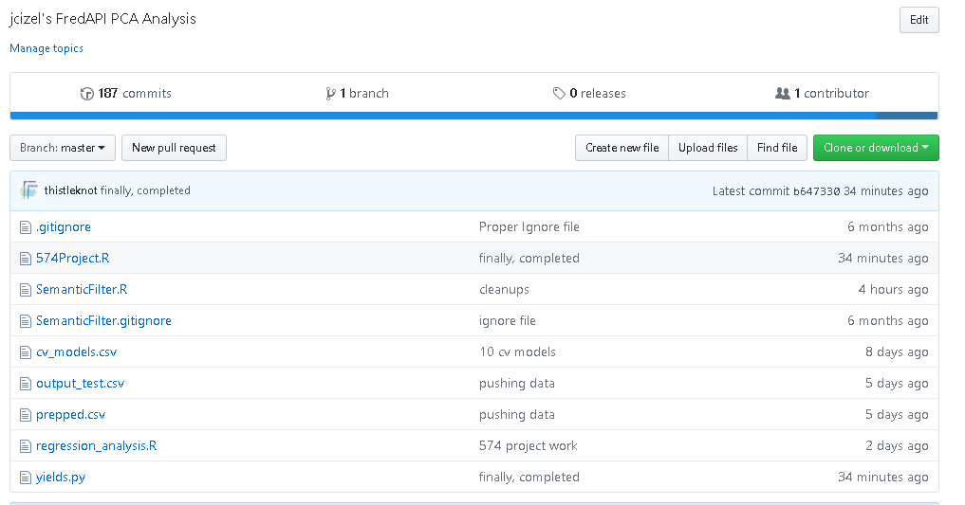
GitHub Project
https://github.com/thistleknot/FredAPIR

Slide 3
Variables
semanticList = c("Population", "Price", "Employment","Consumer", "500", "Monetary Base", "Real", "Money Stock", "Treasury", "Spread")
semanticScore=50
I also add if they are not already
parsedList<-c(unique(names),'TTLHH','EMRATIO','GOLDAMGBD228NLBM','POPTOTUSA647NWDB','USSTHPI’)
CSUSHPINSA: S&P/Case-Shiller U.S. National Home Price Index (Response variable is based on)
yFYield_CSUSHPINSA: derived yield compared with last quarter (predictor response variable)
BL_yFYield_CSUSHPINSA : whether the yield was up (1) or down (0) (classification response variable)

Slide 4
Background
Federal Reserve Data
FREDAPIR
SemanticFilter.R
600 lines of code
Reticulate Library
Yields.py
Na cleanup
Correlation filtering
Derives Yield
80 lines of code
574Project.R
400 lines of code

Slide 5
SemanticFilter.R
Initial acquisition, interpolation
Using a semantic search filter
semanticList = c("Population", "Price", "Employment","Consumer", "500", "Monetary Base", "Real", "Money Stock", "Treasury", "Spread")
and score over 50 popularity
if((as.numeric(as.character(semantic$popularity[count])))>semanticScore)
1st Output: output_test.csv (based on dataframe “new4”) (not used)
ncol(new4)
[1] 237
2nd Output: prepped.csv (used yields.py process)

Slide 6
yields.py
Correlation, data cleanup
called as read_yields()
na removal
correlation analysis
Derive yields
Derive shifted columns
Derive categorical variables
Input: output_test.csv
Output: output.csv (includes na lagged rows)
Output: prepped.csv
Excludes rows with na’s,
finResult.dropna().to_csv("prepped.csv", sep=',', index=False)
Remove final record due to either not being a quarter record, or not have a future yield to pull from. Minor ca
ncol(temp)
[1] 48

Slide 7
547.r
Regression Analysis
574Project.R
Input: prepped.csv

Slide 8
Multiple Regression RMSE Comparisons
RMSE Scores
> fwdstep_rmse
[1] 0.006078305
> bckstep_rmse
[1] 0.005574847
> stepboth_rmse
[1] 0.006071784

Slide 9
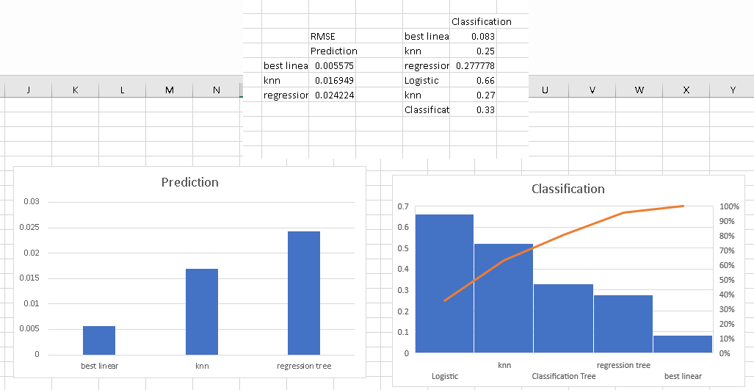
Results

Slide 10
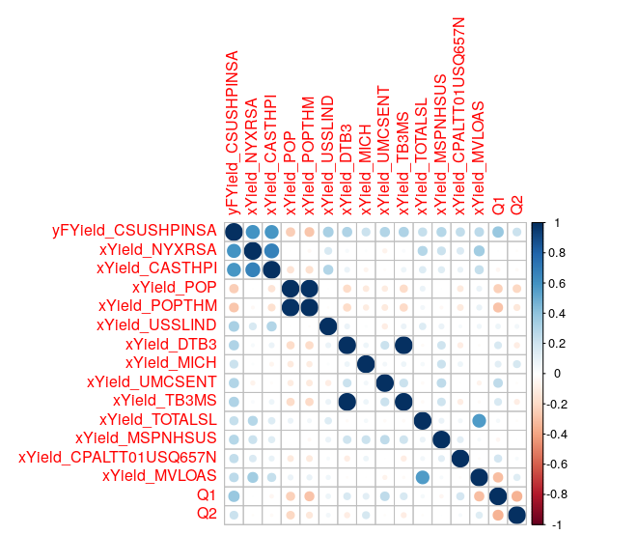
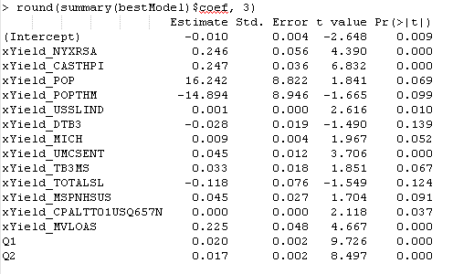
Best Model

Slide 11
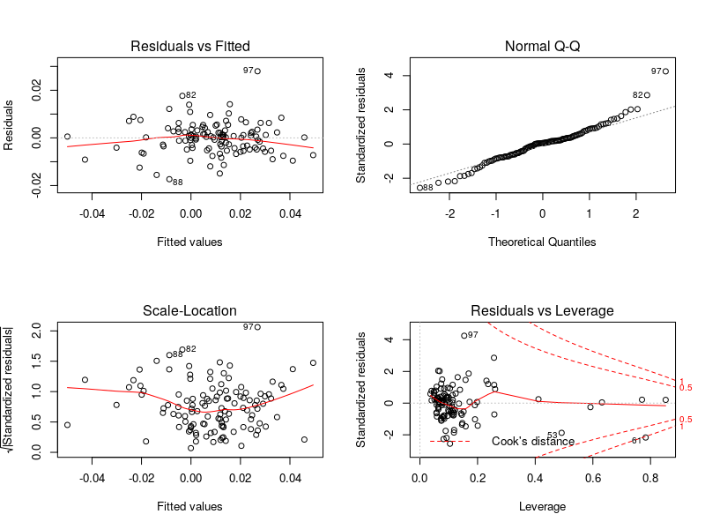
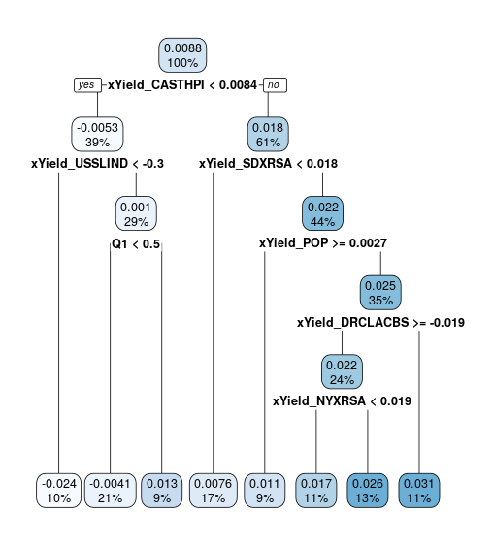
Inferences

Slide 12
Variables Selected
NYXRSA
S&P/Case-Shiller NY-New York Home Price Index | FRED | St. Louis Fed
CASTHPI
All-Transactions House Price Index for California - FRED - Federal ...
POP
Population
POPTHM
Population
USSLIND
Leading Index
DTB3
3 Month Treasury
MICH
Inflation Expectation
UMCSENT
Consumer Sentiment
TB3MS
3 Month Treasury
TOTALSL
Total Consumer Credit
MSPNHSUS
Median Sale Price for New Houses Sold in US
CPALTT01USQ657N
Consumer Price Index
MVLOAS
Motor Vehicle Loans
Q1
Q2

Slide 13
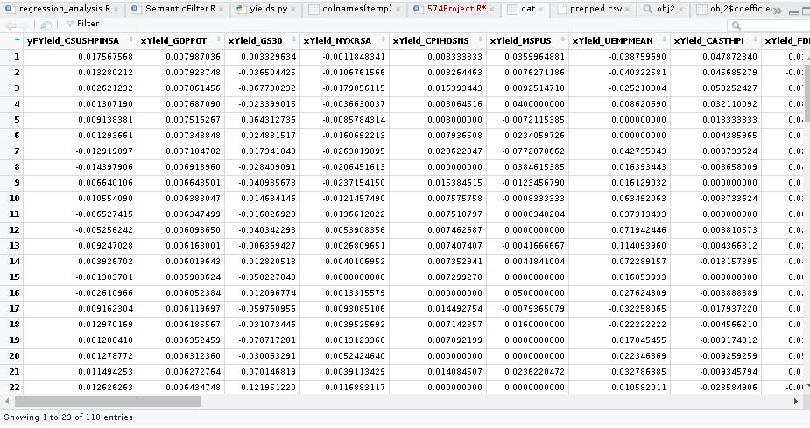
Example output

Slide 14
Further Direction
Principle Component Analysis
Seasonal trends
Cross Validation
http://www.milanor.net/blog/cross-validation-for-predictive-analytics-using-r/
How to interpret R Leverage Charts
https://data.library.virginia.edu/diagnostic-plots/
Reticulate Library
https://rstudio.github.io/reticulate/
Lift Charts
https://heuristically.wordpress.com/2009/12/18/plot-roc-curve-lift-chart-random-forest/

